Slide 1

SPEECH END POINTING GROUP MEMBERS: CS-18137, CS-18141 & CS-18144

Slide 2

VERY PERI
WHAT IS SPEECH ENDPOINTING:
Speech endpoint detection is an important part of modern speech information processing technology.
Identified as the starting point and endpoint of speech signal accurately
Plays an important role in speech signal processing.
endpoint detection directly improves the performance and quality of speech coding, speech recognition, speech synthesis, speech enhancement and echo cancellation.
Introducing the Pantone Color of the Year 2022. PANTONE 17-3938 Very Peri is a dynamic hue that blends the faithfulness and constancy of blue with the energy and excitement of red.
The four color palettes in this template feature Very Peri to help you express your ideas and convey the right mood. Read on to learn how to use these colors in any presentation.

Slide 3
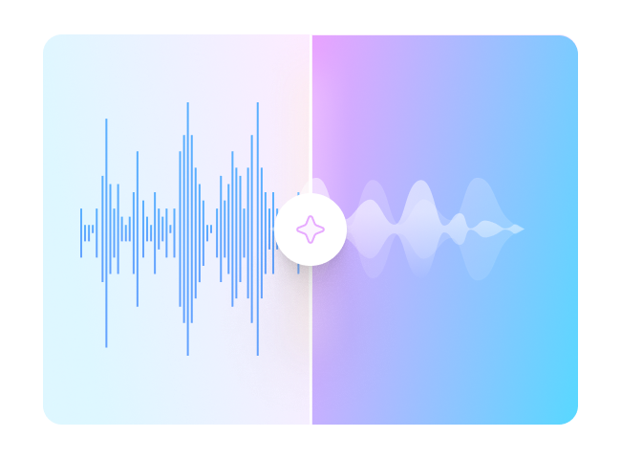
ALGORITHMS
BOTH ZERO CROSSING RATE AND SHOT TIME ENERGY ARE USED TO SEPERATE VOICE AND UNVOICE REGIONS.
THEY BOTH GIVE EFFICIENT RESULT, INCREASING PROCESSING SPEED AND ARE RELIABLE

Slide 4
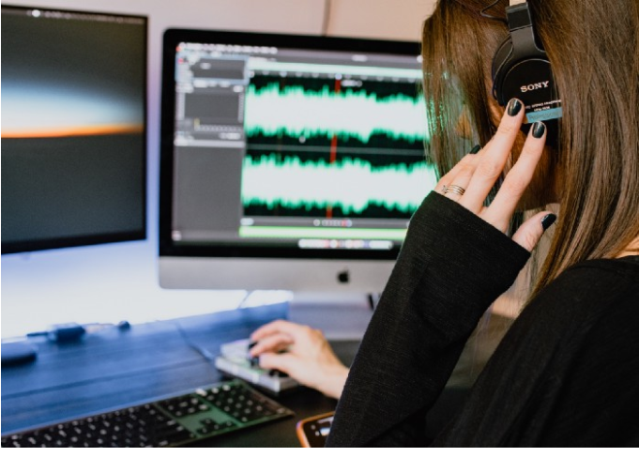
Zero crossing RATE:
A zero-crossing is a point where the sign of a mathematical function changes.
Used in speech recognition & music information retrieval.

Slide 5

SHORT TIME ENERGY
By the nature of production, the speech signal consist of voiced, unvoiced and silence regions.
It can be used for voiced, unvoiced and silence classification of speech.

Slide 6


RELATION WITH DSP:
THE DSP CALCULATES THE ZERO CROSSING OF THE SPOKEN WORDS AND ACCORDINGLY GENERATES DIFFERENT ANALOG SIGNALS AT IT OUTPUT. THESE ANALOG SIGNALS ARE FURTHER PROCESSED SO AS TO OPERATE THE APPLIANCES.

Slide 7
FLOW DIAGRAM
VOICE RECORDING
SIGNAL OUTPUT
BEGIN & END POINTS
THRESHOLD DEFINED
FRAMING
FRAME LENGTH & SHIFT
ZERO CROSSING RATE
SHORT TIME ENERGY
HAMMING WIDOW
CORRESPONDING TIME OF EACH FRAME
SIGNAL LENGTH
TIME SCALE OF SIGNAL
N FRAME FRAMING
FRAME NUMBER CALCULATION

Slide 8
CODE
SHORT TIME ENERGY AND ZERO CROSSING RATE:
%short time energy
for i=1:fn y=X(:,i);%Data per frame
b=0;
for m=1:1:200 %This is based on the frame length.
b=b+y(m).^2;
end
E(i)=b;
End
%zero-crossing rate
Z=zeros(1,fn); % Initialization
for i=1:fn
y=X(:,i);%Data per frame
b=0;
for m=1:1:199 %Depending on the frame length
if y(m)*y(m+1)<0
b=b+1;
end
Z(i)=b;
end
end
RECORD AND FRAME:
recordSignal = recordfile(8000, 5);
x=getaudiodata(recordSignal);
fs=8000;
wlen=200;%Frame length
inc=100;%Frame shift
win=hamming(wlen);%hamming window
N=length(x);%Signal Length
time=(0:N-1)/fs;%Calculate the time scale of the signal
X=enframe(x,win,inc)'; %Framing,A column is a frame.
fn=size(X,2);%Frame number
frameTime=frame2time(fn,wlen,inc,fs);%Find the corresponding time of each frame

Slide 9
THRESHOLDING BEGIN AND END POINT:
%Find the threshold of short-term energy to determine the beginning and end of speech
zeros(i);
q=[];%Store the location of the start voice boundaries
i1=1;
while (i1<length(E))
for i1=i1:1:length(E)
e=E(i1);
if e>0.1
q=[q i1-1];
i1=i1+1;
for i2=i1:length(E)
e=E(i2);
if e<0.1
q=[q i2+1];
i1=i2+1;
break
end
end
break
end
end
end
%Zero-crossing rate
zeros(i);
w=[];
i1=1;%Storage End Speech Limit Location
while (i1<length(Z))
for i1=i1:1:length(Z)
e=Z(i1);
if e>120
w=[w i1];
i1=i1+1;
for i2=i1:length(Z)
e=Z(i2);
if e<50
w=[w i2+1];
i1=i2+1;
PLOTTING OF GRAPHS:
%Drawing
subplot(311)
plot(time,x);
title('original signal')
xlabel('time');ylabel('Range');
subplot(312)
plot(frameTime(q),E(q),'or');
hold on
plot(frameTime,E);
title('short time energy')
xlabel('time');ylabel('Range');
subplot(313)
plot(frameTime(w),Z(w),'or');
hold on
plot(frameTime,Z);
title('Zero-crossing rate')
xlabel('time');ylabel('frequency');
disp(fn);
disp('begin');
disp(q);
disp('end');
disp(w);
function frameTime=frame2time(fn,wlen,inc,fs)
frameTime=(((1:fn)-1)*inc+wlen/2)/fs;
end

Slide 10

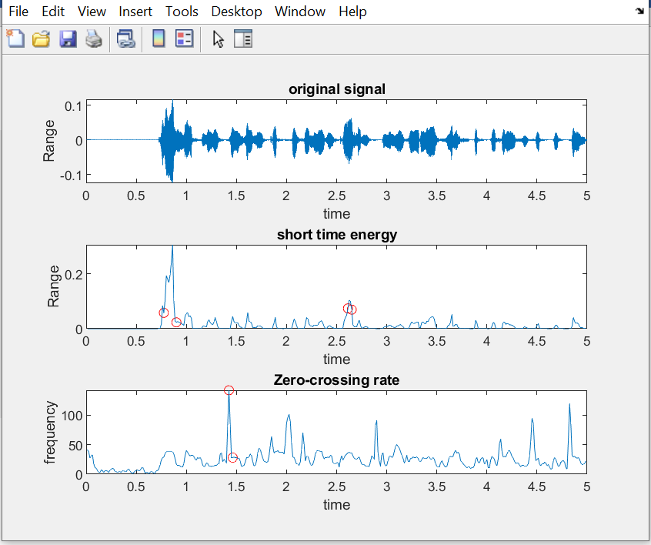
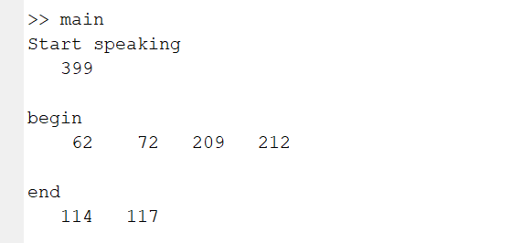
NORMAL VOICE

Slide 11
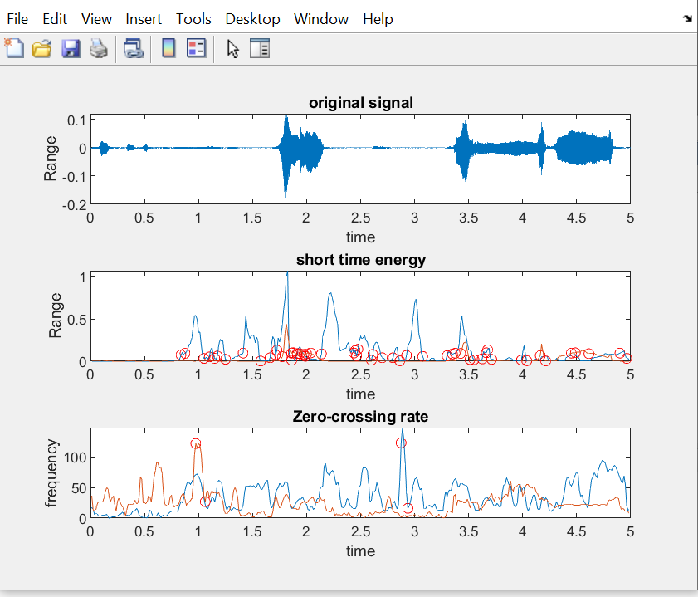
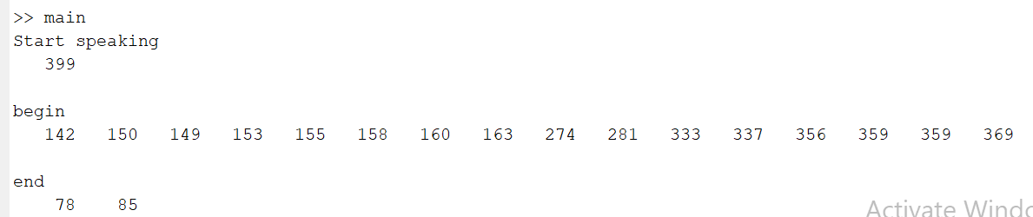
NORMAL VOICE WITH NOISE

Slide 12
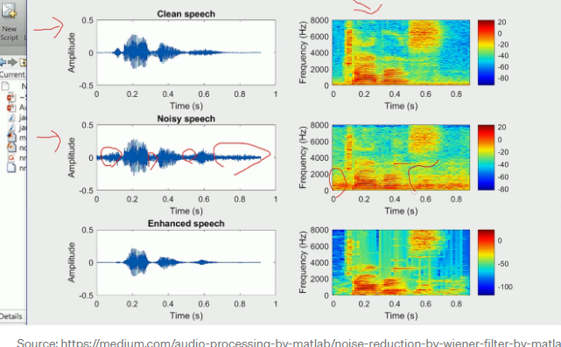
NOISE REMOVAL:

Slide 13

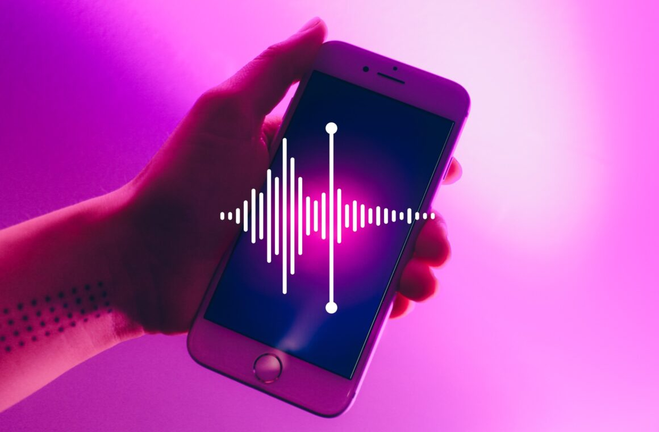
THANK YOU!

